Slide 1

Model Writer
Work Package 1 - Industrial Use Cases and Requirements
Eray TÜZÜN (HAVELSAN )
Yagup MACİT (HAVELSAN)

Slide 2
T1.4 – Industrial Use Cases for Turkish Consortium
UC-TR-03 | Integration with ALM tools
Versioning Info | V1.0.0 dated 28-Apr-2015
Description | Show that the ModelWriter can extract required elements from structured requirement objects in ALM tool to generate automatic design model. Show that the ModelWriter’s can generate requirements specification document from structured requirement objects in ALM tool.
Actors | Requirements Engineer/Manager, System/Software Architect
Assumptions | All the traceability information would continue to be followed from the structured requirement object via ALM tool. (ModelWriter does not need to have any traceability information) Textual representation of requirements are stored in MS Word documents. Design models are stored in Sparx Systems Enterprise Architect. Structured requirement objects are stored in Microsoft Team Foundation Server.
Steps | Scenario1: From a set of structured requirement objects in the ALM tool, ModelWriter would create a natural-language text requirement document. Scenario2: From a set of structured requirement objects in the ALM tool, ModelWriter would create/synch a design model. From a design model, ModelWriter would create/synch to a set of structured requirement objects.
Variations (optional) | Scenario1: From a natural-language text requirement document, ModelWriter would create/synch to a set of requirement objects.
Non-functional (optional) | The system should have a Word plugin for natural-language text transformation. The natural-language support should be in both English and Turkish
Issues | A common format between ALM platforms and ModelWriter may need to be implemented.

Slide 3
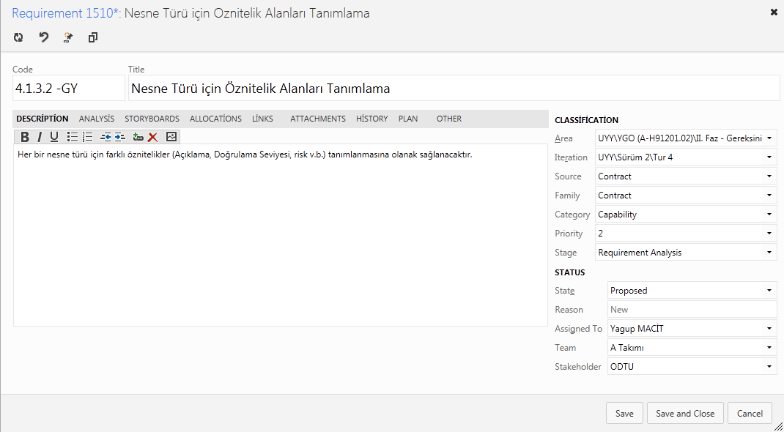
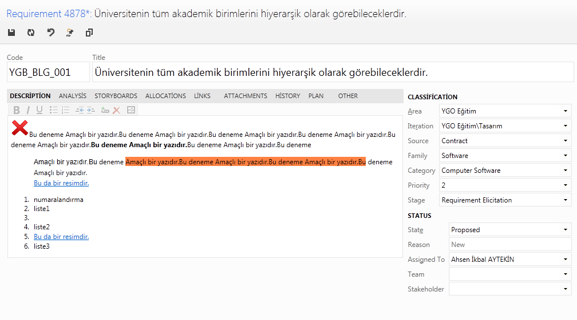
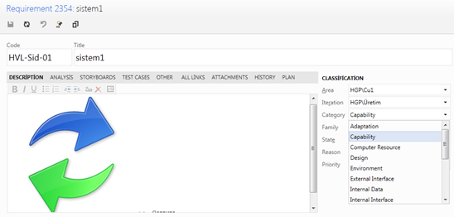
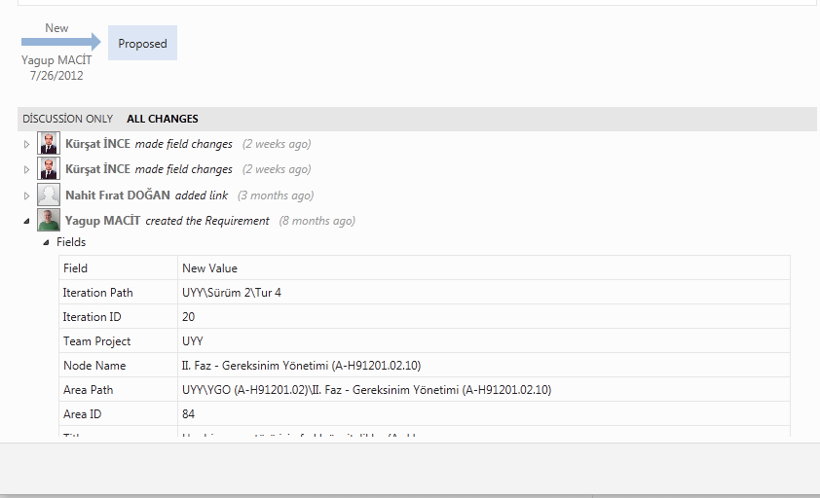
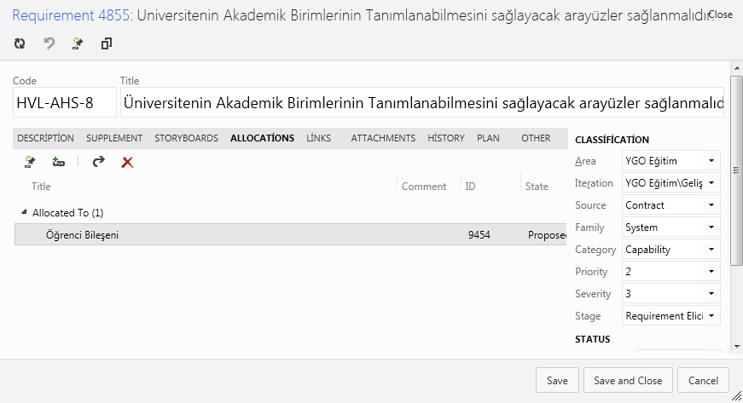
Requirement Work Item
Customized Form
Attributes
WorkItem Number Patterns
History
Discussion

Slide 4
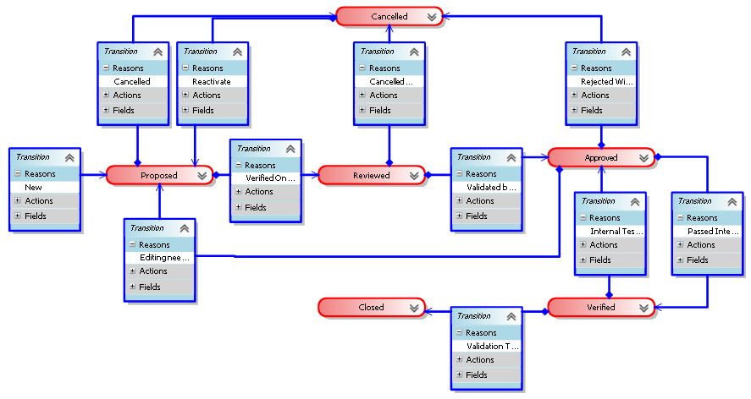
Requirement LifeCycle
Notes:
We defined a structured requirement object as an entity, that have a set of lifecycle states, defined transitions between these states, history of changes, related attributes (unique id, priority, severity, validation method etc.), and traceability information to various project artefacts such as other requirements, design model, source code, bugs, test cases etc.

Slide 5
Modeling Artifacts in ALM

Slide 6
Requirements in ALM
Traceability with other artifacts is key
Requirements to other requirements
Customer/System/Software/Hardware..
Dependency relation between requirements
Requirements to tasks (Project management)
Requirements to Test Cases
Requirements to Design elements
Requirements to generated documents
Requirements to source code
Requirements to Build
Requirements to bugs
Requirements to risks
…
Notes:
Requirements Engineering is not a separate activity. It is part of ALM. Requirements as a document or a separate entity does not mean anything.
A lot of the big software development companies have made a lot of investments to build an integrated ALM platform which would cover the entire lifecycle of an application.
This Use Case aims at integrating ModelWriter with requirements management portion of the Application Lifecycle Management (ALM) tools. In a typical ALM platform, “requirement” is represented as a structured requirement object rather than text.

Slide 7
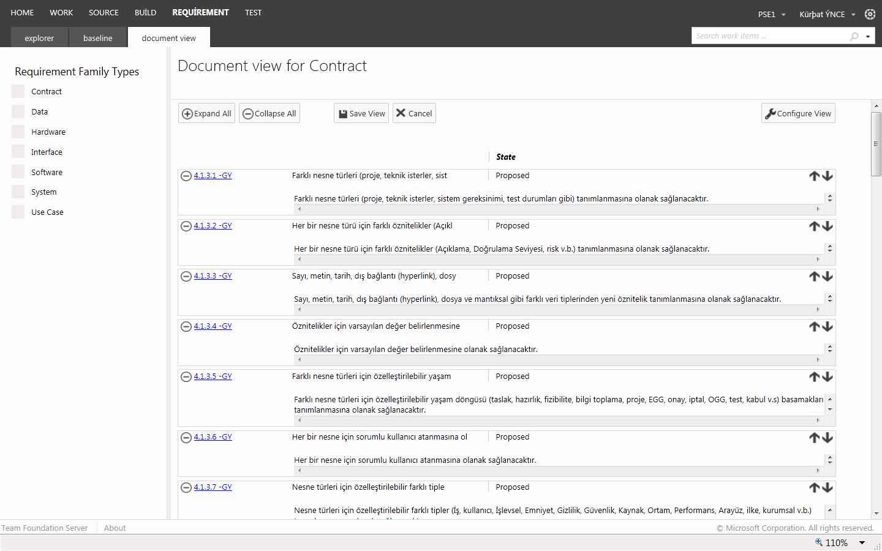
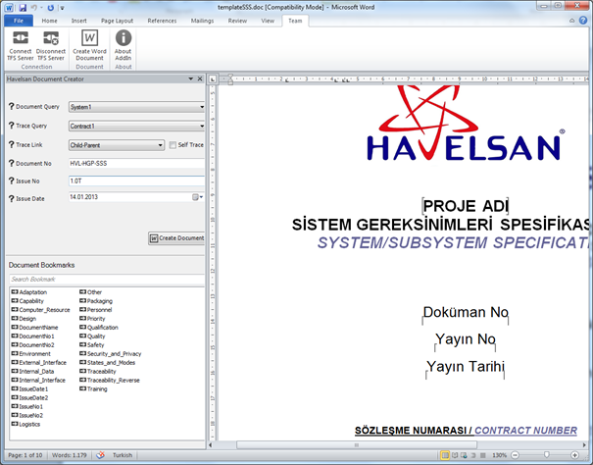
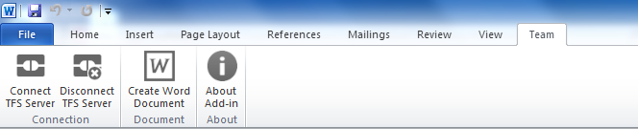
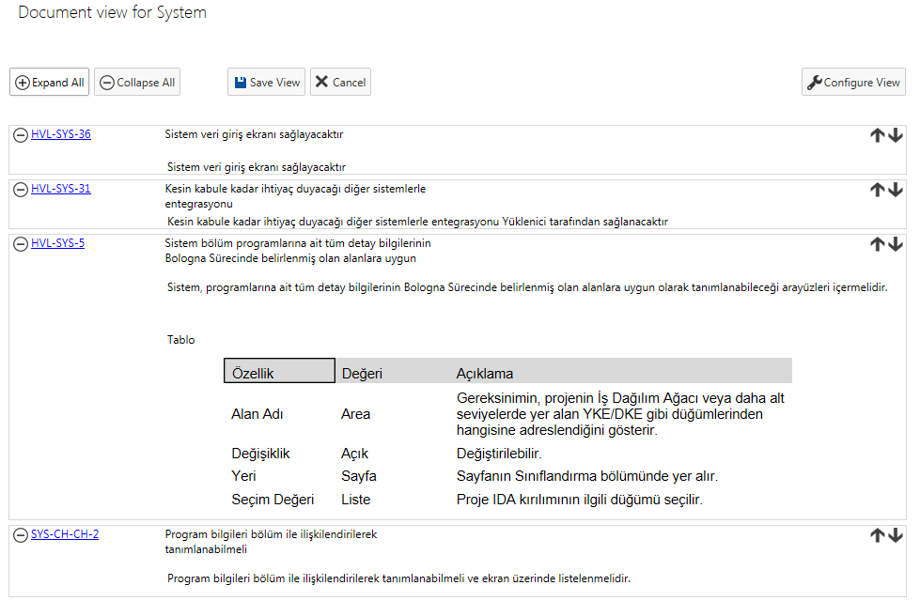
Havelsan Ext - Document Generation
Preview
Word Extension
Support for Templates

Slide 8
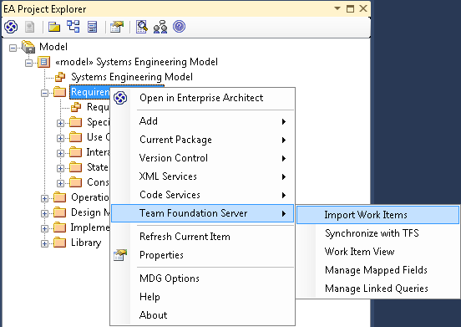
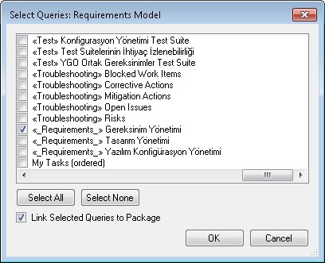
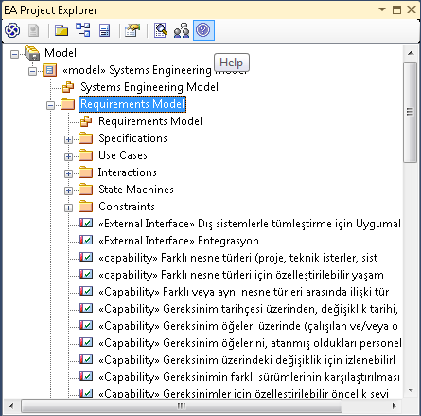
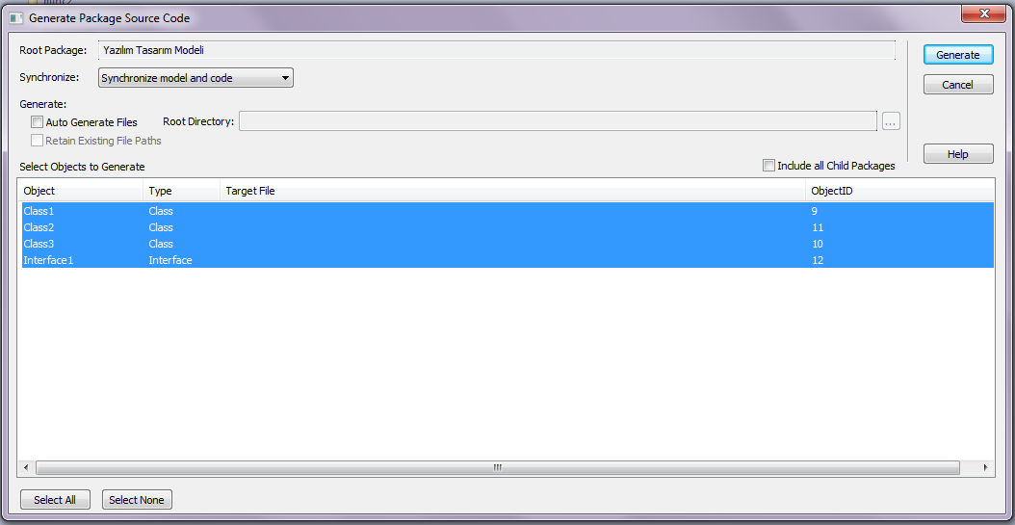
Requirements - Design Model Traceability
Requirements would be imported to the Design tool for traceability.
Code generation from design

Slide 9
HAVELSAN Use case for ModelWriter
Currently we support scenario #1 and #4, and interested in Scenario #3, #2

Slide 10
Thank you for your attention! Any question ?

